Slide 1



Are songs getting shorter?
Group 5 – Big Data Technology

Slide 2
WHOLENESS
Using Big Data Technologies for retreiving and storing Meta-Data of Songs on Spotify to analyze various interesting facts. E.g. Are songs getting shorter in the past decades?

Slide 3
PIPELINE
Analysis Spark SQL
Visualization Zeppelin
Fetching Data Spotify API
KAFKA
Spark Stream
Distributed Database

Slide 4

PIPELINE
Analysis Spark SQL
Visualization Zeppelin
Fetching Data Spotify API
KAFKA
Spark Stream
Distributed Database
! Spotify allows only limited requests ! To simulate real time we needed to accumulate data by frequently fetching from Spotify to a Kafka Broker.

Slide 5
PIPELINE
Spotify API
Analysis Spark SQL
Visualization Zeppelin
STREAMER
SHIM
Kafka Broker
SPARK STREAM
Distributed
Database

Slide 6
INITIAL SETUP
FETCHING DATA
SPOTIFY WEB API
Fetching to two places.
Data in JSON Format
Spotify API
Requesting every 5 seconds top 100 songs from a specific year.
( ∞Loop from 1961 – 2014 )
STREAMER
SHIM
File Server
BACKUP Local File System

Slide 7
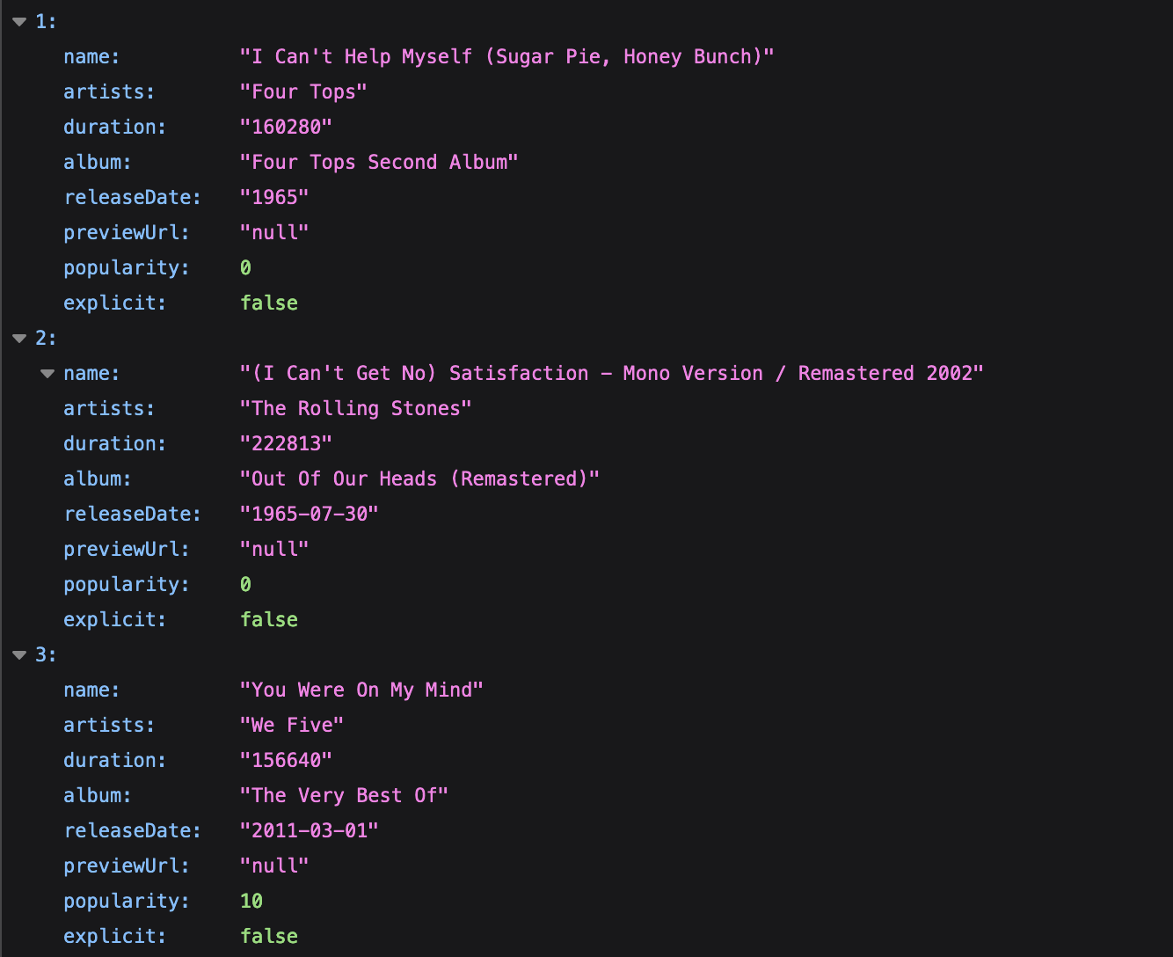
SPOTIFY WEB API
FETCHING DATA
Data Sample

Slide 8
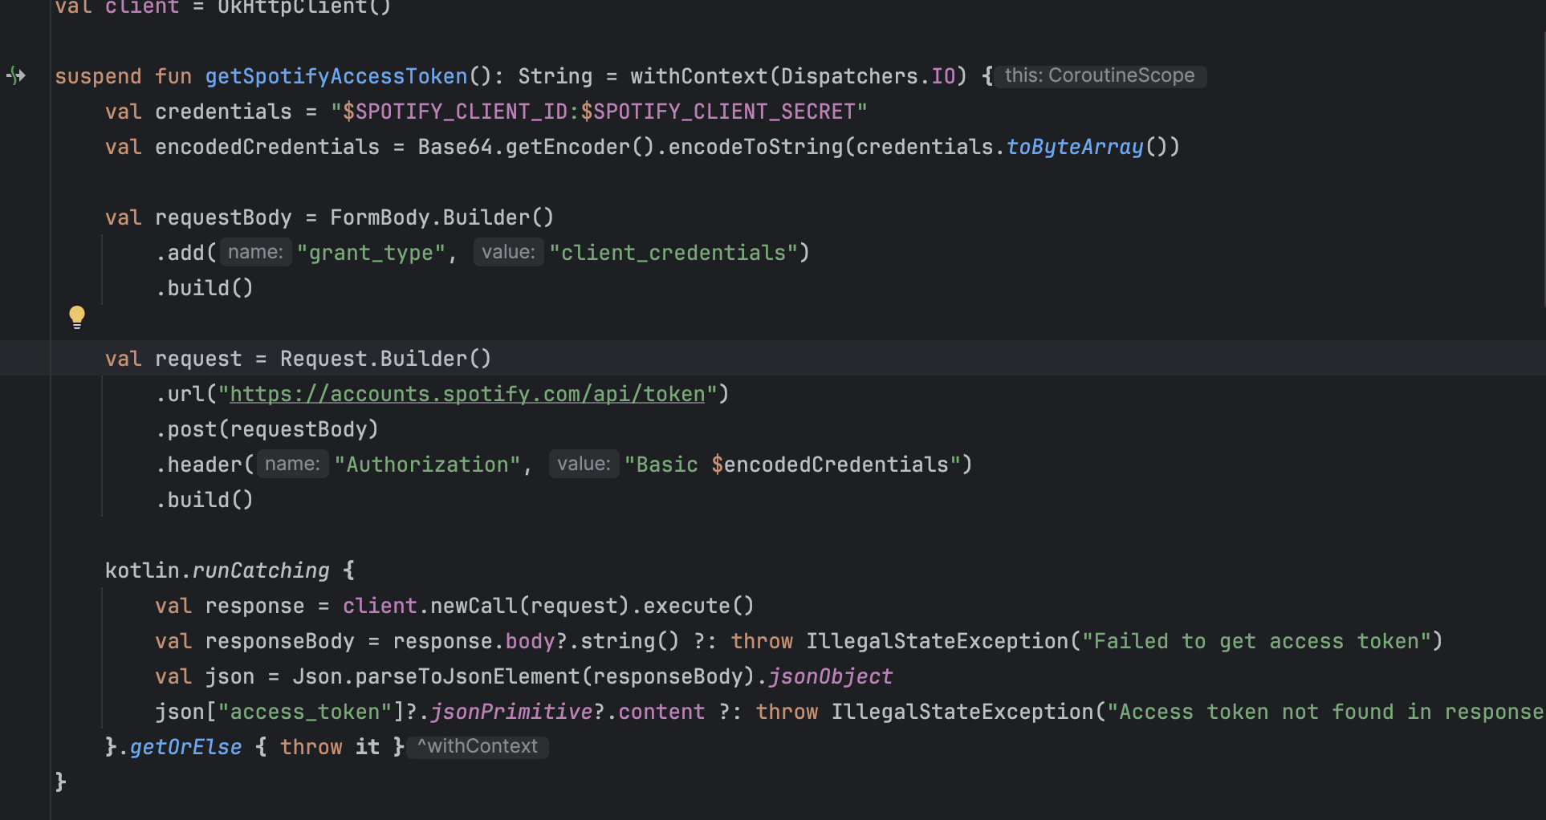
SPOTIFY WEB API
FETCHING DATA

Slide 9
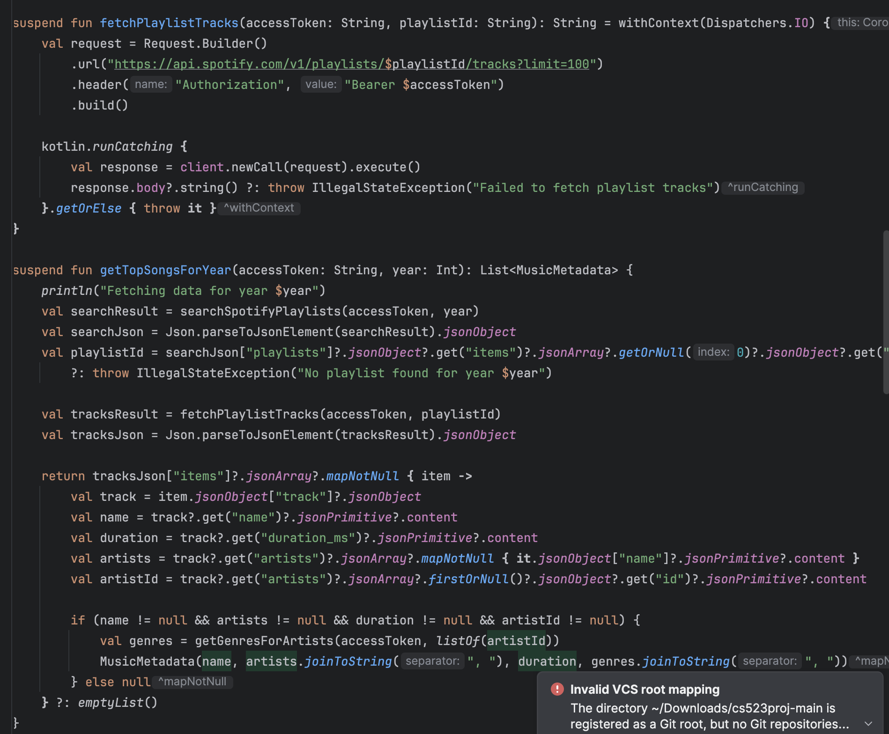
FETCHING DATA

Slide 10
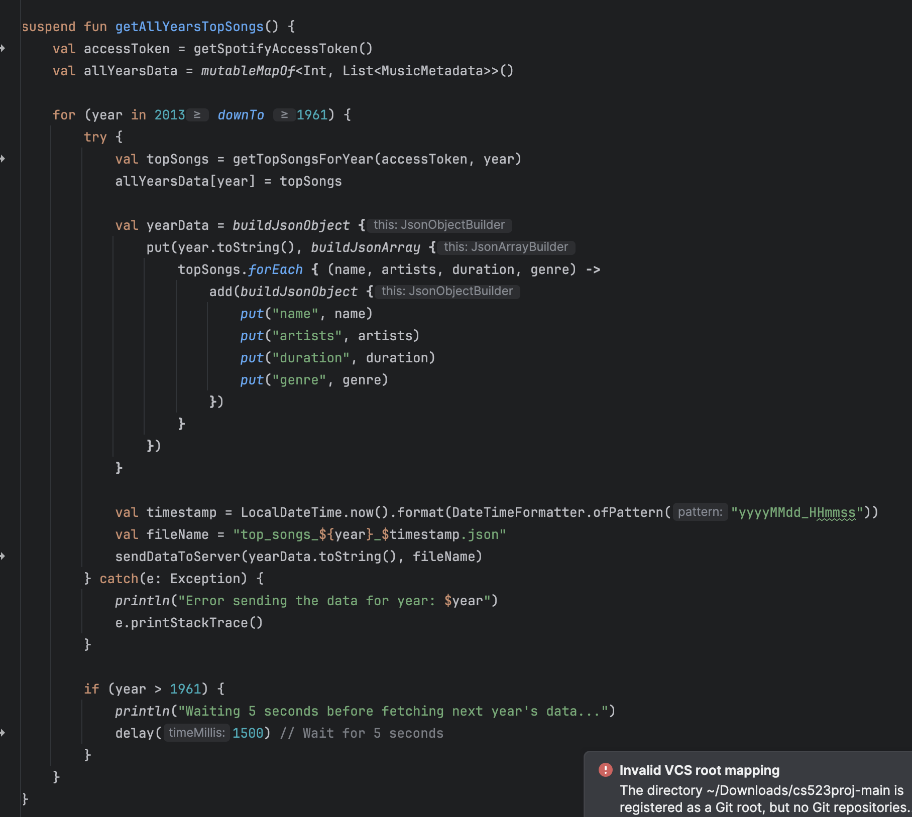
FETCHING DATA

Slide 11
Imports
KAFKA PRODUCER
@file:DependsOn("org.apache.kafka:kafka-clients:3.0.0")
import org.apache.kafka.clients.producer.KafkaProducer import org.apache.kafka.clients.producer.ProducerConfig import org.apache.kafka.clients.producer.ProducerRecord import org.apache.kafka.common.serialization.StringSerializer

Slide 12
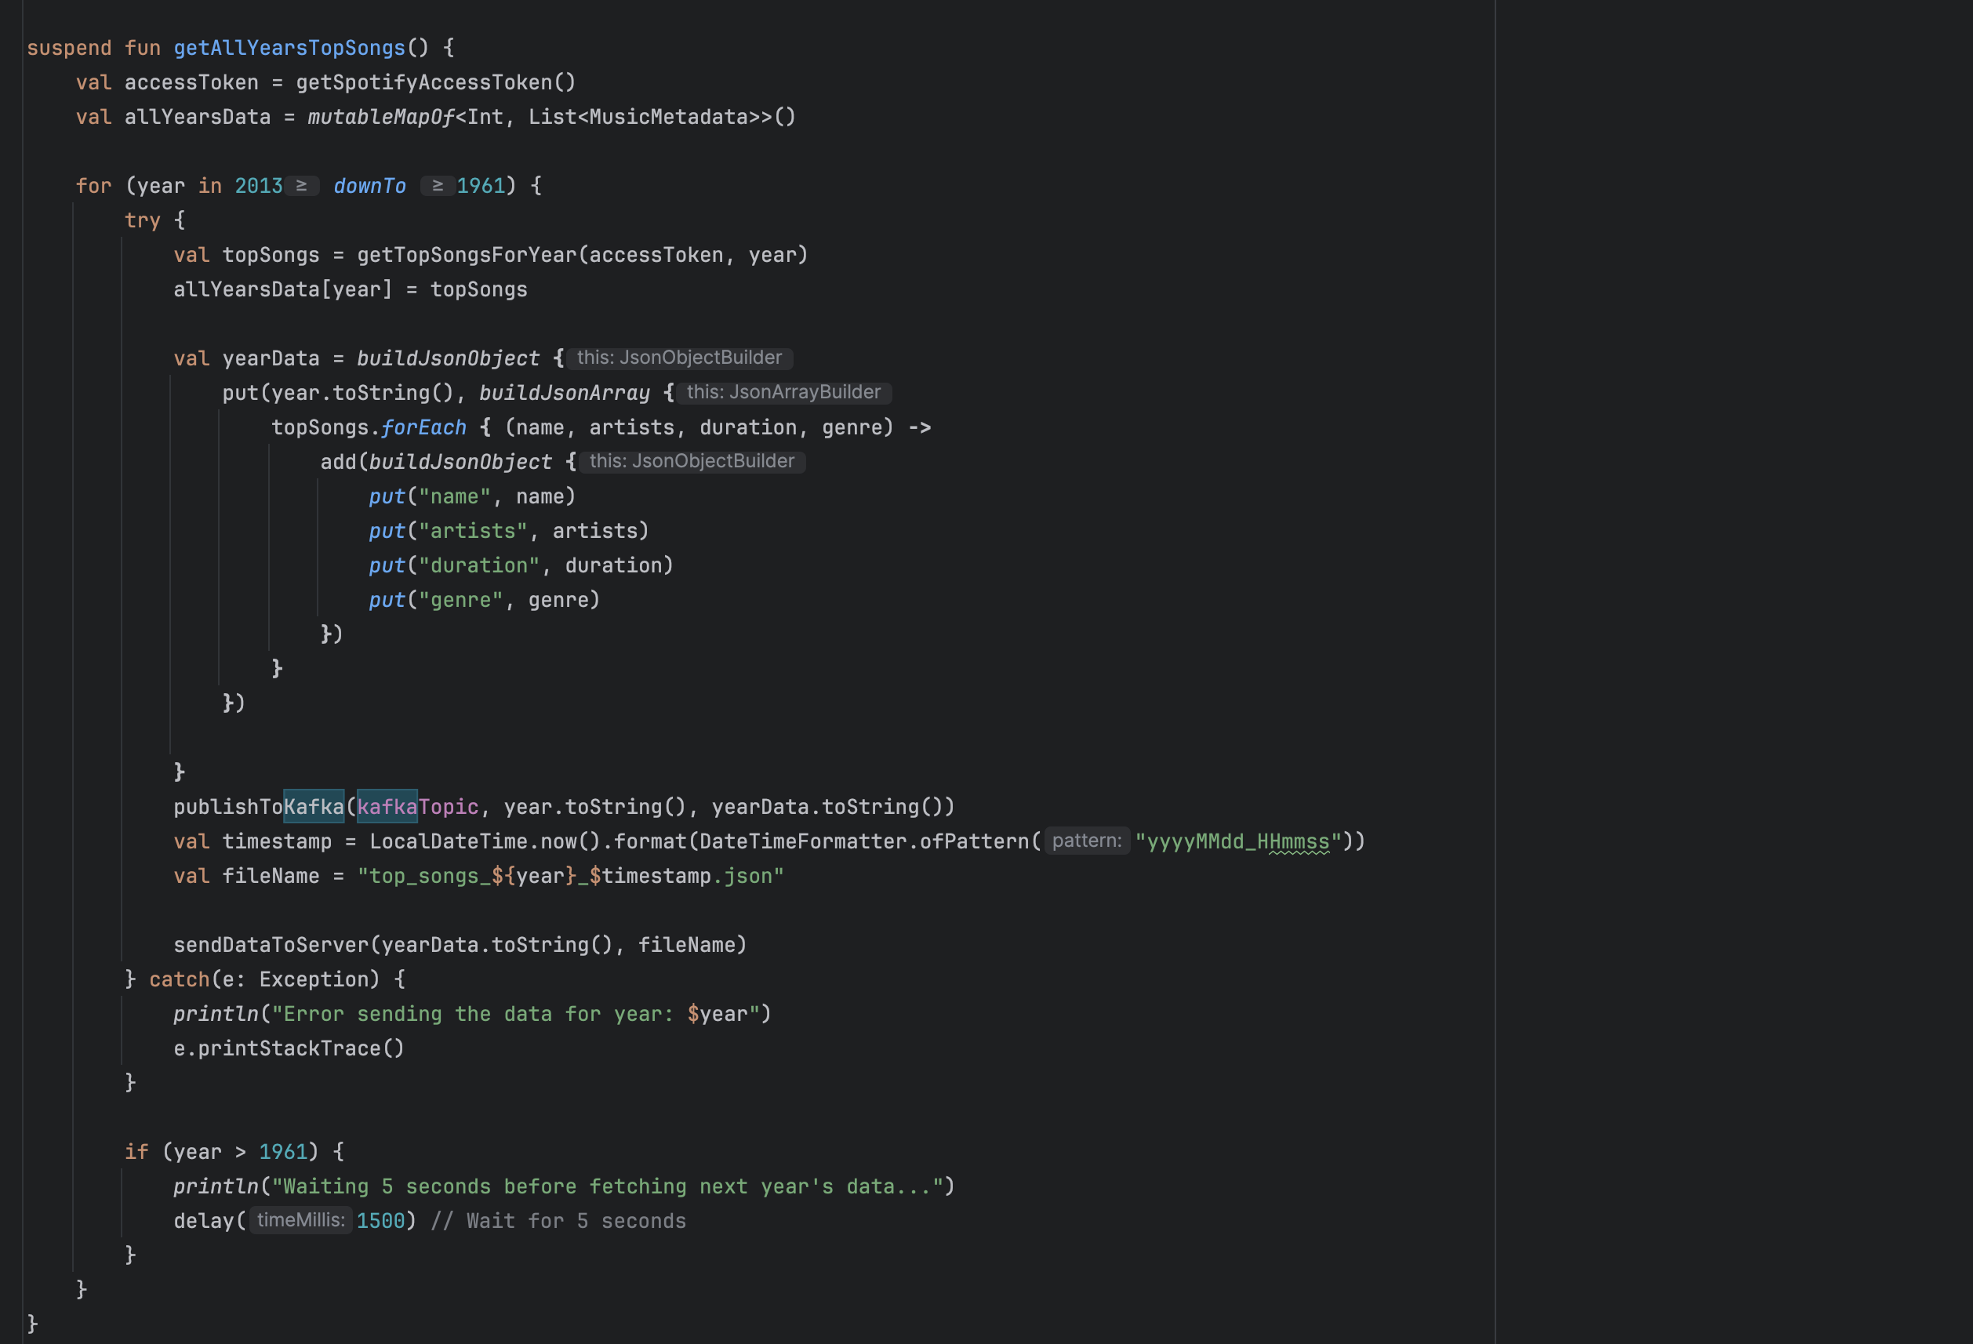
KAFKA PRODUCER

Slide 13
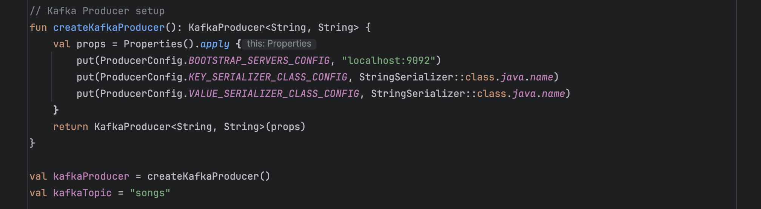
KAFKA PRODUCER

Slide 14
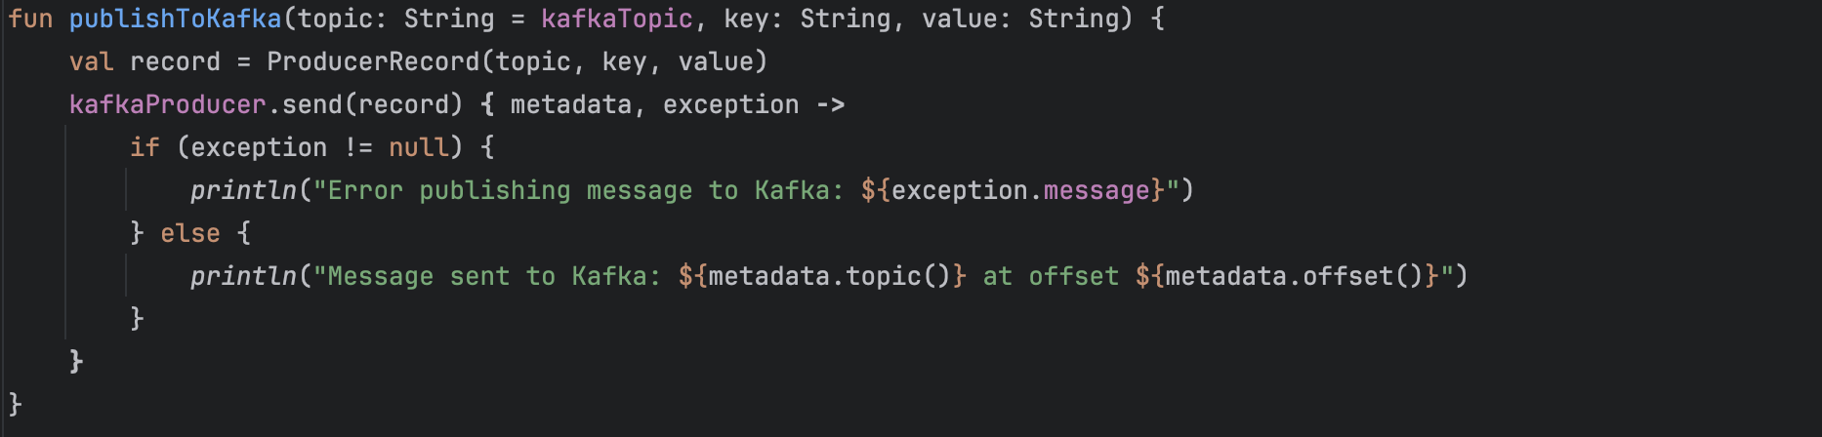
KAFKA PRODUCER

Slide 15

Spark Stream Purposes

Slide 16
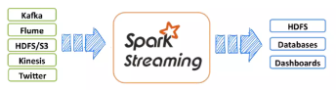
Spark streaming purpose is to process real-time data from various sources and make it available for use in other systems: Data sources
Spark Streaming can process data from a variety of sources,
including Kafka, Flume, Amazon Kinesis, and web APIs like Twitter
Data destinations
Processed data can be sent to file systems,
databases, or live dashboards.
Processing techniques
Spark Streaming uses batch processing techniques to process
data by dividing continuous data streams into small batches

Slide 17
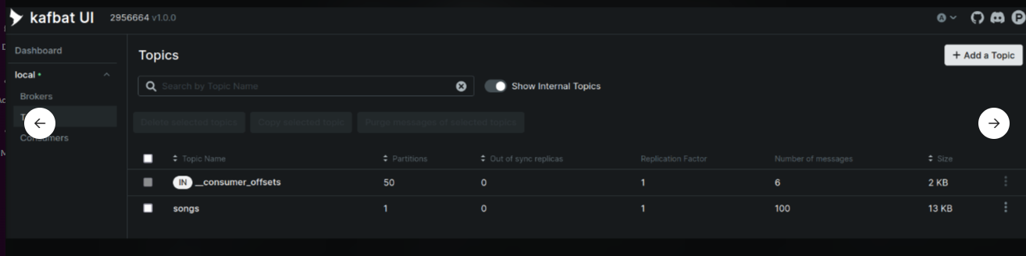
This Kafka UI(Kafbat) displaying two topics in a local Kafka cluster, including details about their partitions, replication factor, and message counts.
The Kafka UI shows two topics in a local Kafka cluster: __consumer_offsets with 50 partitions used for tracking consumer group offsets, and songs with 1 partition for user data. Both topics have a replication factor of 1, indicating no redundancy. The UI also displays the message count and size for each topic, helping monitor their data load and health.

Slide 18
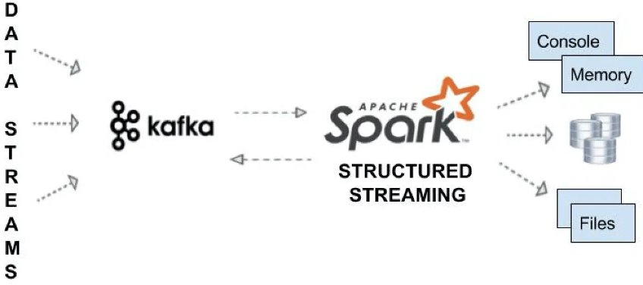
Topic: A Kafka topic is a category or stream where records or messages are published by producers.
Subscription: A subscription allows consumers to receive messages from one or more Kafka topics.

Slide 19
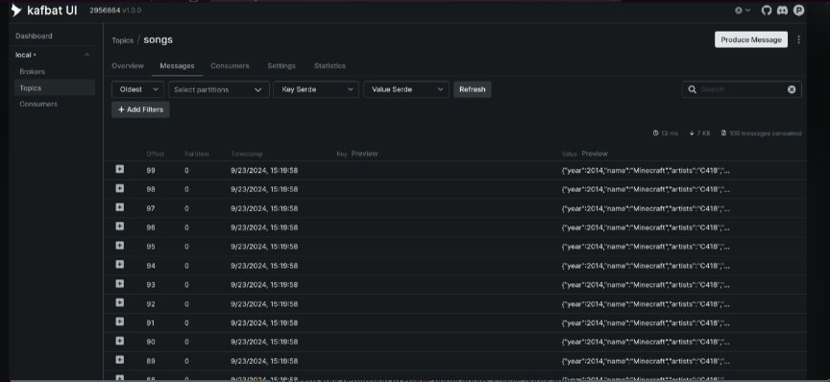
This Kafka UI is displaying the message log for the "songs" topic, including message offsets, partitions, timestamps, and previews of message content.

Slide 20
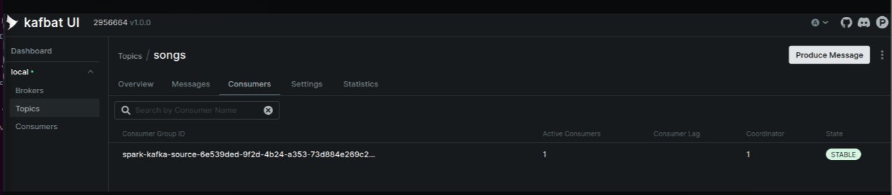
Here it shows Kafbat UI monitoring the Kafka topic songs. It displays one active consumer with a stable connection, indicating that the Spark streaming application is successfully consuming messages from the topic.

Slide 21
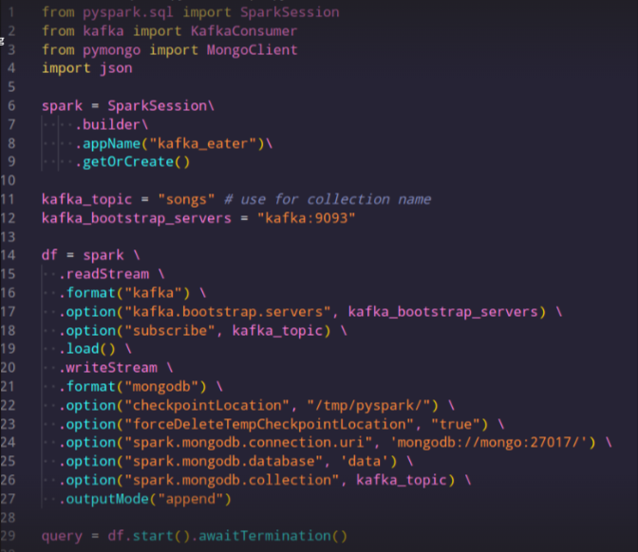
Streaming job using PySpark to read data continuously from a Kafka topic (songs) and write it to a MongoDB collection (also named songs).

Slide 22
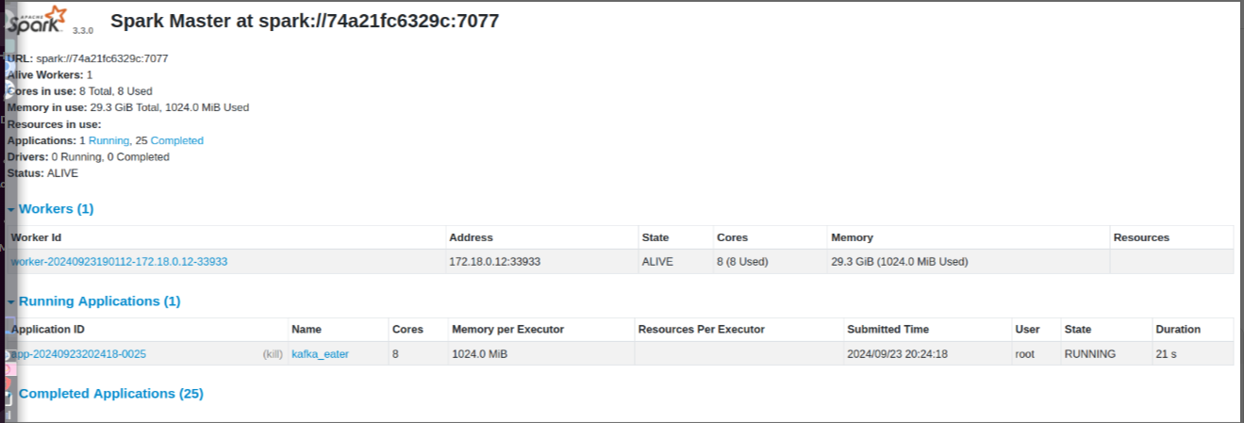
Spark Master node which is monitoring the cluster's status:
The Spark Master UI shows the status of the cluster, with 1 active worker node using 8 cores and 29.3 GB of memory. It lists one running application, kafka_eater, utilizing 8 cores and 1024.0 MB of memory per executor. The application is currently in a running state with a submitted time of 21 seconds.

Slide 23


Slide 24
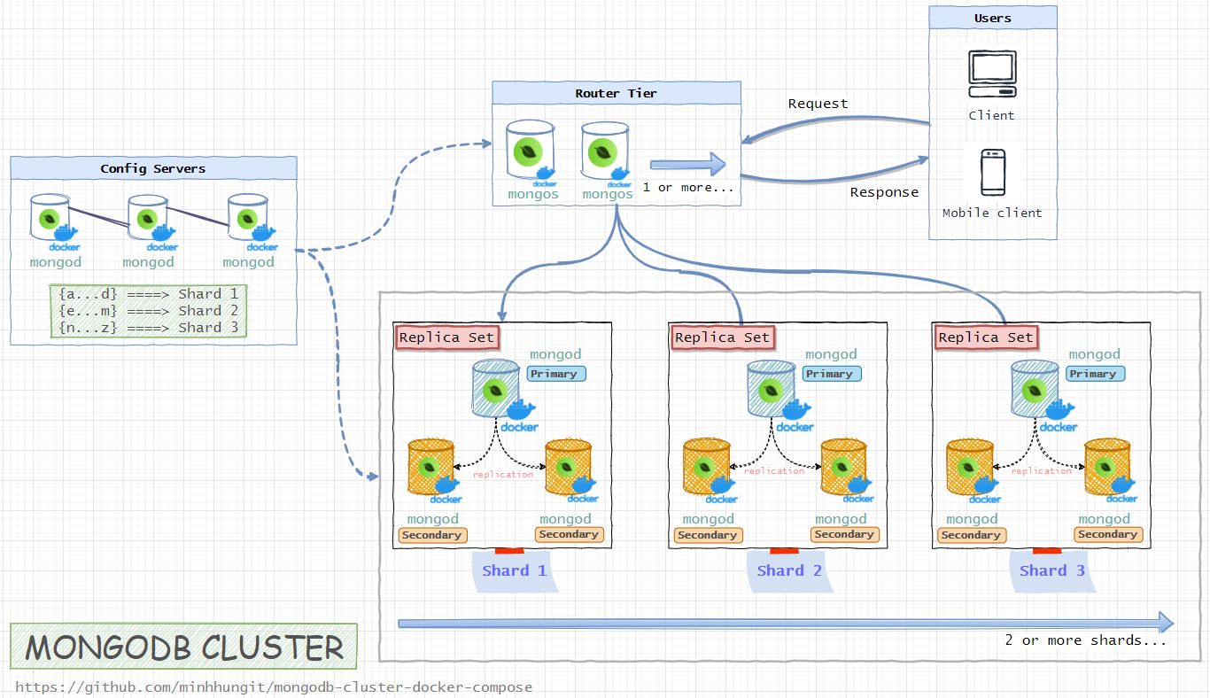
STORAGE
SURPRISE !
MONGODB - CLUSTER
Exploring a different approach to HBase

Slide 25
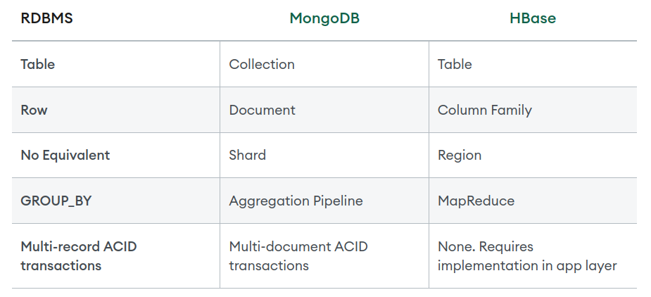
STORAGE
MONGODB - CLUSTER

Slide 26
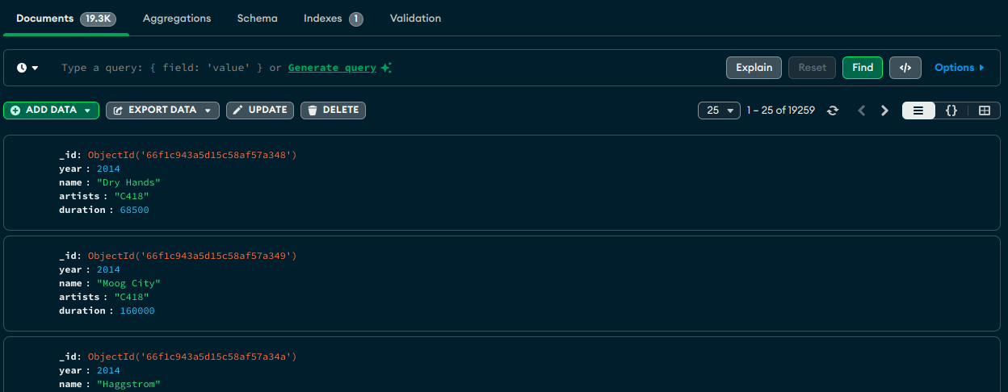
STORAGE
MONGODB - CLUSTER
Stores the metadata of every song in one big table.

Slide 27
ANALYSIS
SPARK SQL
Finding out:
Average song duration per year
Average title length per year
Top 10 most occurring words in title and their count
Top 10 most occurring artists and their count
STREAMER
SHIM
Notes:
1)
# Get the average song duration for each year
df.select("year", explode("data.duration").alias("duration"))
.groupBy("year")
.avg("duration")
.show()

Slide 28
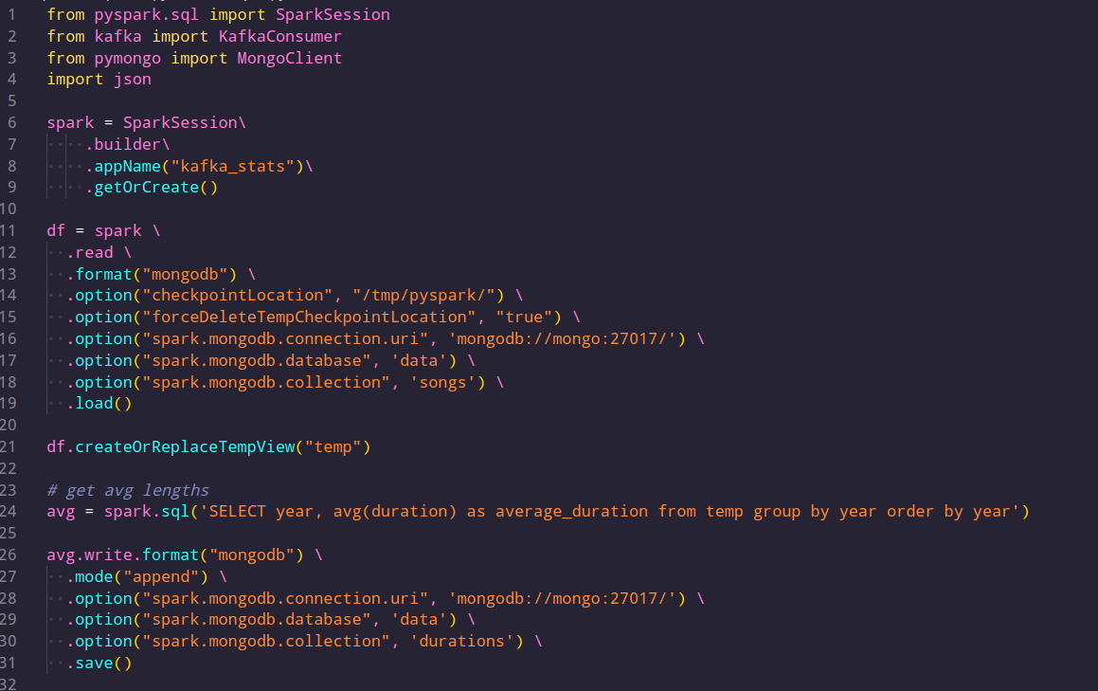

Slide 29
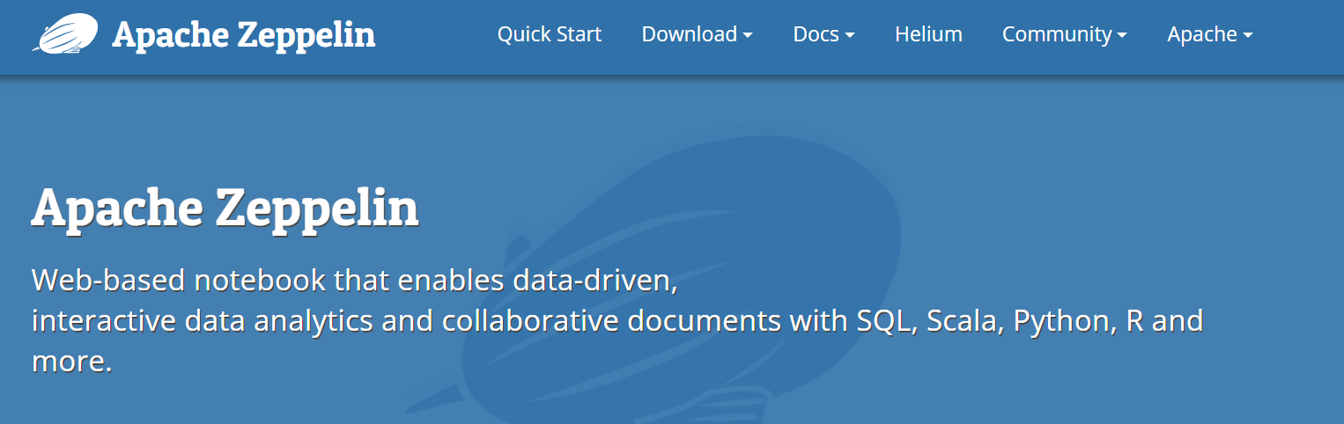
VISUALIZATION
Zeppelin
STREAMER
SHIM

Slide 30
VISUALIZATION
Zeppelin
Notebook: Create notes, which have paragraph(s) Various Interpreters: executing paragraphs and displaying results
We use Matplotlib library as visualization tool
Built-in support for Spark + Direct Integration with Hbase using JDBC
Execute Spark SQL commands + visualize results immediately.
Notes:
a "notebook" is an interactive document that combines code, visualizations, and narrative text. It allows users to write and execute code in real time, document their thought processes, and visualize data—all within a single interface.

Slide 31
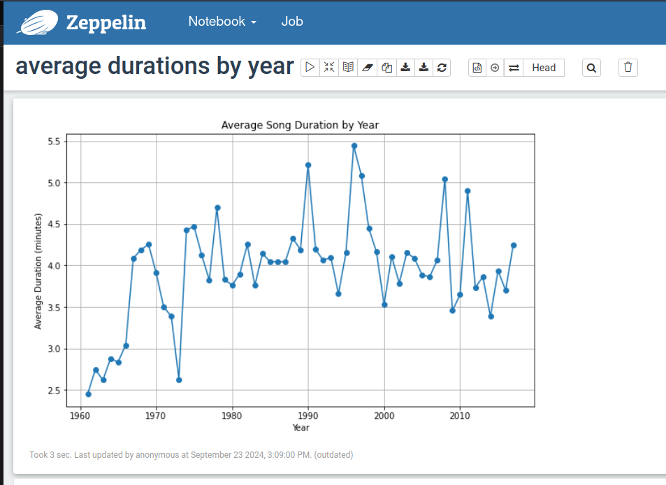
VISUALIZATION
STREAMER
SHIM

Slide 32
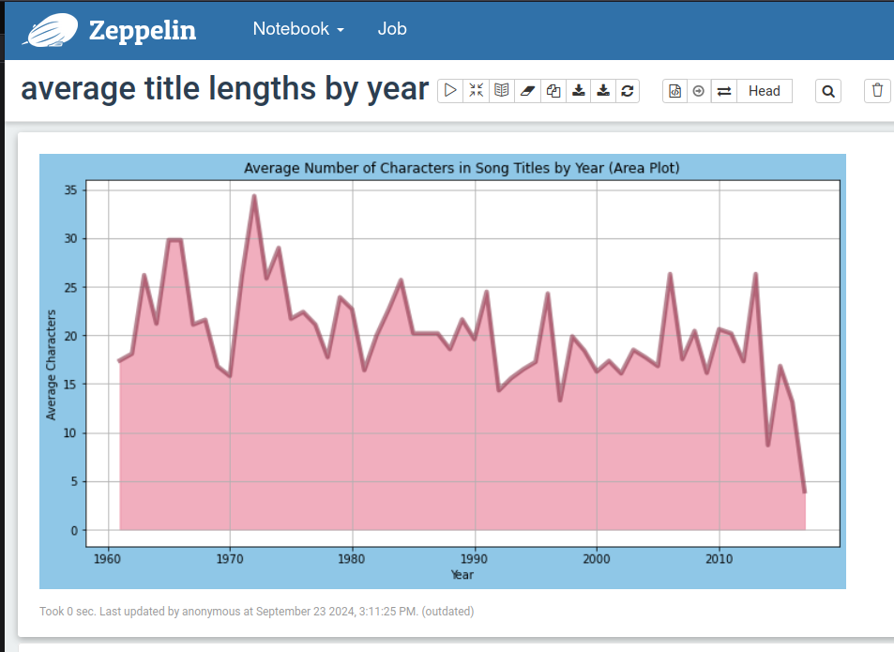
Input
STREAMER
SHIM

Slide 33
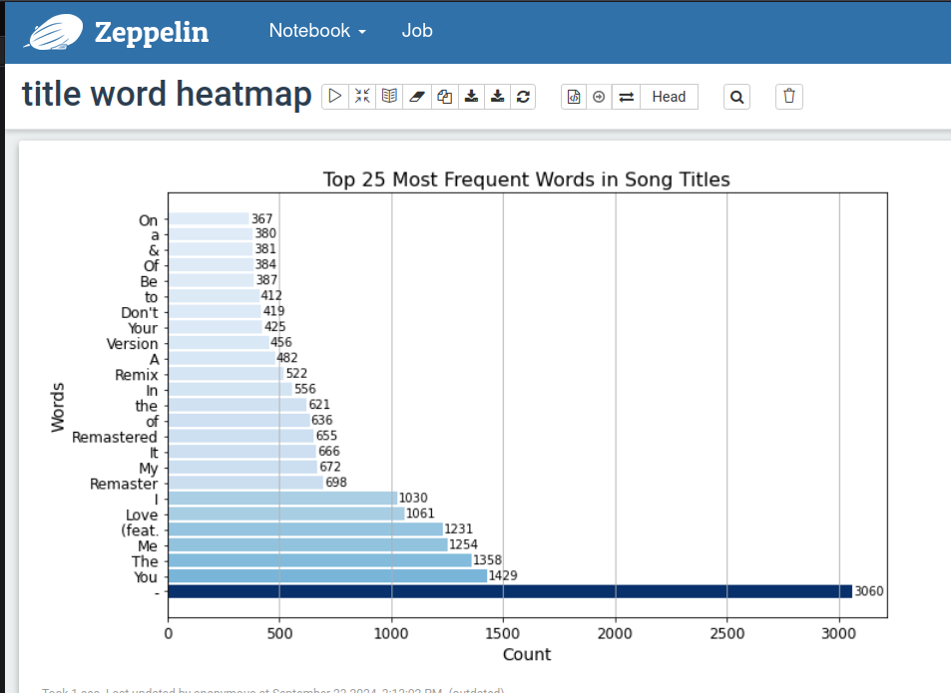
Input
STREAMER
SHIM

Slide 34
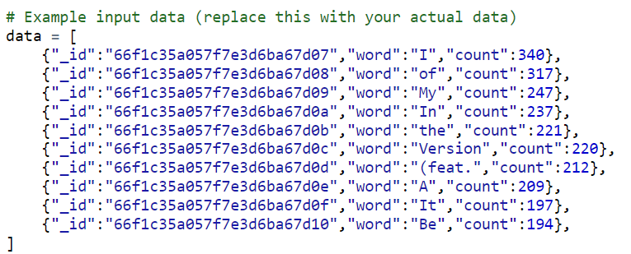
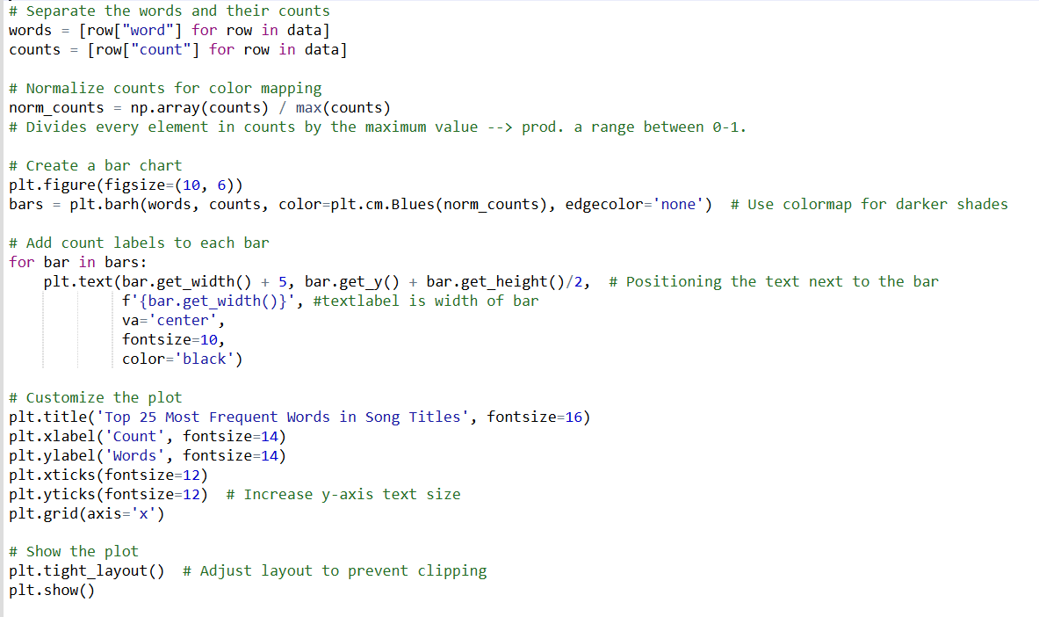
Input
STREAMER
SHIM

Slide 35
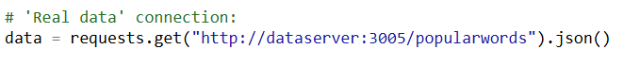
Input
STREAMER
SHIM

Slide 36
Input
STREAMER
SHIM

Slide 37
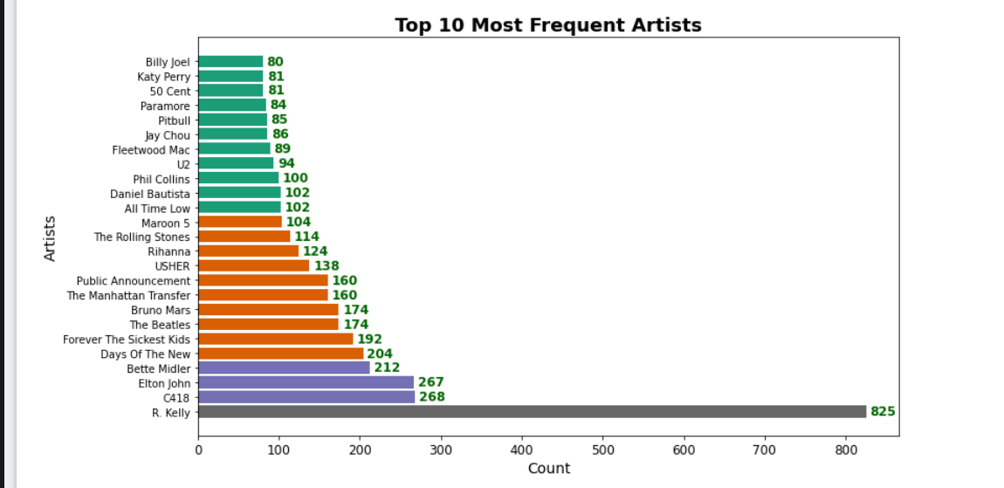
Input
STREAMER
SHIM

Slide 38
SCI
KNOWLEDGE HAS ORGANIZING POWER
By knowing the metadata of many songs AND by knowing the tools to process and analyse it, we are able to organize it in a way that answers questions and gives us insights.
Similarily by knowing our true Self, the unified field of all the laws of nature – we know the very foundation of life, which means that we are able to access the tools that structure our entire creation and use it to be very successful in life.

Slide 39

